Slide 1
Alma Brenda Cruz Ortiz Brenda Elizabeth López Gómez Michelle Alondra Delgado Romo Diana Rosalba Pérez González

Slide 2
SELECTION GAME “PICTURE THE VERB” https://www.turtlediary.com/game/picture-the-verb.html

Slide 3
REASONS:
We chose it because:
It’s fun
It has visual aids
It is productive
It give you feedback
It provides pronunciation
USES:
As a review or quiz
As a race
OBJECTIVE:
To test students’ knowledge about verbs
To help students’ understanding of the verbs and their uses

Slide 4
ADAPTATION ACTION VERBS
CHANGES:
The amount and the difficulty of the verbs depend on the level of the students.
The images change to be atractive according to their age.
USES:
As a handout for them to study the verbs
As a guide to create a story
As a guessing game
OBJECTIVE
To have students relate the verbs with their action.
To recognize the verbs and practice them.

Slide 6
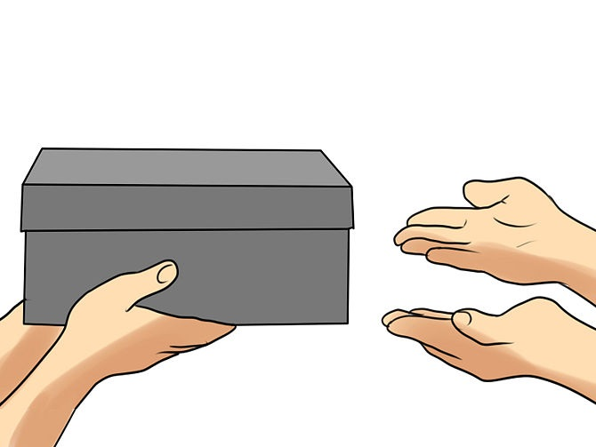
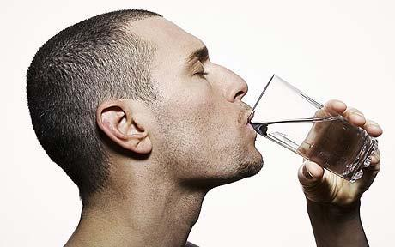
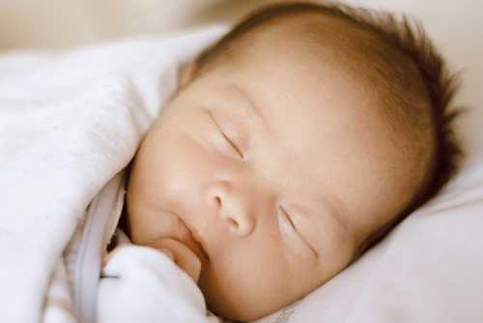
Action verbs
GIVE
TALK
WRITE
DRINK
EAT
RUN
RIDE
JUMP
MEET
SLEEP
THINK
DRIVE

Slide 7
DESIGN VERB CARDS
NEED
A material that allows students to see the different forms of a simple verb
USES:
As a guessing game:
To show a card in infinitive for students to say the simple past and past participle form
As a game:
Divide the group in two teams.
Teacher will show a card with one verb to each member in infinitive. This person is going to run to another team member for him/ her to say the verb in the correct form. This will be repeated until all of the verbs run out.
The team who says more verbs correctly is the winner.
OBJECTIVE:
Identifying the different forms of the verbs.
To memorize them in a fun way.

Slide 8
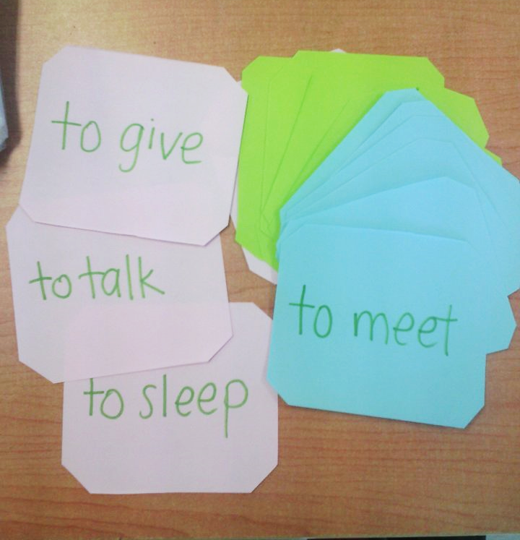
|

